Slide 1
Introduction to Programming

Slide 2
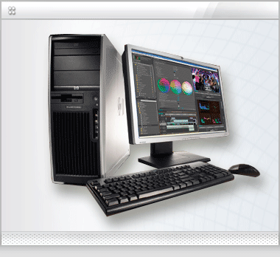
What is a computer?
A computer, (also known as a PC) is a programmable machine that receives input, stores and manipulates data, and provides output in a useful format.

Slide 3
What is a computer?
A computer, derived from its name, can perform calculations and can make logical decisions.
A computer runs millions or billions faster than human beings.

Slide 4
What is a computer program?
A computer program is a sequence of instructions written to perform a specified task for a computer. A computer requires programs to function, typically executing the program's instructions in a central processor. The program has an executable form that the computer can use directly to execute the instructions.

Slide 5
What is a computer program?
The same program in its human-readable source code form, from which executable programs are derived (e.g., compiled), enables a programmer to study and develop its algorithms.
Computer programs may be categorized along functional lines: system software and application software. Two or more computer programs may run simultaneously on one computer, a process known as multitasking.

Slide 6
What is computer programming?
Computer programming is the process of designing, writing, testing, troubleshooting, and maintaining the source code of computer programs.

Slide 7
What is computer programming?
This source code is written in a programming language. The purpose of programming is to create a program that exhibits a certain desired behavior. The process of writing source code often requires expertise in many different subjects, including knowledge of the application domain, specialized algorithms and formal logic.

Slide 8
What is a programmer?
A programmer is someone who writes computer software. A programmer can be referred to a specialist in one area of computer programming or to a generalist who writes code for many kinds of software.
A programmer also writes the computer source codes.

Slide 9
What is a programming language?
A programming language is an artificial language designed to express computations that can be performed by a machine, particularly a computer.
Programming languages can be used to create programs that control the behavior of a machine, to express algorithms precisely, or as a mode of human communication.

Slide 10
The Programming Cycle Processes
Problem Definition – the investigation and separation of the problem in smaller related units
Program Designing – includes the formation of an algorithm such as flowcharting and a pseudo-code
Encoding/Coding – enter the coded instructions into the computer system
Validation – testing of solution design with a set of data and correcting the errors if present

Slide 11
The Programming Cycle Processes
Verification – running a program in order to verify the accuracy and workability of the solution
Debugging – process of identifying, locating and correcting the errors in solution
Documentation – it is the records of the program for later application, variables are defined and comments are placed and are informative
Explanation – explaining the program for the people who will use it

