Slide 1
With a calculator does it matter in which order you push the buttons?

Slide 2
Answer: YES

Slide 3
PROGRAMS
When you use a calculator to compute 10 plus 5, you must push:
10 + 5 = ... in exactly that order.
Pushing+ 10 = 5 ... will not work. The order is important. The same is true for computer programs.
A program is like a recipe for baking cookies: it is a list of instructions which are followed one-by-one in the correct order.

Slide 4
Isn't it odd that a machine can follow a list of instructions?

Slide 5
Yes. Until a few decades ago few people believed that this was possible. One of the intellectual goals of this course is for you to understand how machines can follow instructions.

Slide 6
BASIC PROGRAMMING (Beginner's All-purpose Symbolic Instruction Code)

Slide 7
BASIC
In computer programming, BASIC
(an acronym for Beginner's All-purpose Symbolic Instruction Code) is a family of high-level programming languages.
The original BASIC was designed in 1964 by John George Kemeny and Thomas Eugene Kurtz at Dartmouth College in New Hampshire, USA to provide computer access to non-science students.

Slide 8
QBASIC
QBasic is an IDE (INTEGRATED DEVELOPMENT ENVIRONMENT) and interpreter for a variant of the BASIC programming language which is based on QuickBasic.

Slide 9
QBASIC
A QBasic program consists of lines of text, one after another, like a poem.
A line which has an instruction for the computer is called a statement.
Not all lines are statements.
Some lines are blank. Others are comments intended for a human reader, but not for the computer.

Slide 10
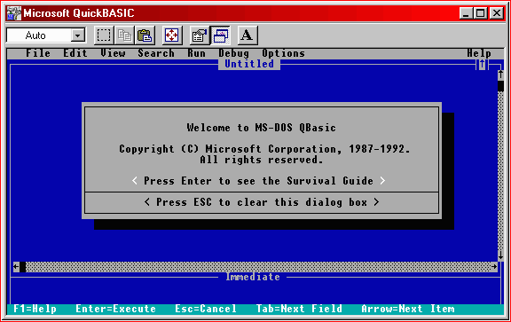
QBASIC ENVIRONMENT

Slide 11
MY FIRST PROGRAM
Type the following (including the quotation marks) in the QBasic interpreter:
PRINT "HelloWorld!”
END <press Enter>

Slide 12
RUNNING THE PROGRAM
Now press F5 to run the program. You should now see a black screen, with Hello World at the top, and Press any key to continue at the bottom.
Press a key on the keyboard to return to the main screen.
(The next figure displays the "output screen.")

Slide 13
OUTPUT SCREEN

Slide 14
REMEMBER!
If you run the program again, the interpreter adds another Hello World.
QBasic adds Hello World each time the program is run.
To avoid this, use the CLS command by typing it at the first line of the codes.

Slide 15
COMMANDS
A "command" tells the QBasic interpreter to do something.

Slide 16
THE “PRINT” COMMAND
The PRINT command tells the QBasic interpreter to print something to the screen. In this case, the interpreter printed "Hello World!".

Slide 17
THE “PRINT” COMMAND
With the PRINT command, you can also print numbers to the screen. Delete the current program (unless you already have) and write the following:
PRINT 512 (or ?512)
<press Enter>
Press F5 to run the program. The program outputs:
512

Slide 18
THE “END” COMMAND
The last statement in the program is END, which just tells the computer that the program is finished.

Slide 19
How many statements are in this program?

Slide 20
ANSWER:
Two.
END is a statement. It tells the system to end this run of the program.

Slide 21
EXPRESSIONS
An expression is something the interpreter calculates (or evaluates). Such as:
1 + 1 (returns 2)
100 - 47 (returns 53)
3 * 34 (returns 102)
80 / 4 (returns 20)
(100 * 3) + 56 (returns 356)

Slide 22
Look at the program:
PRINT 10 + 5
END
If you run this program, the computer starts with the first statement:
PRINT 10 + 5
That statement says to:
1. Add the number 10 to the number 5
2. Print the result on the computer monitor (the computer screen).
This is like an electronic calculator where you enter 10, +, 5, and =. The calculator then shows 15.

Slide 23
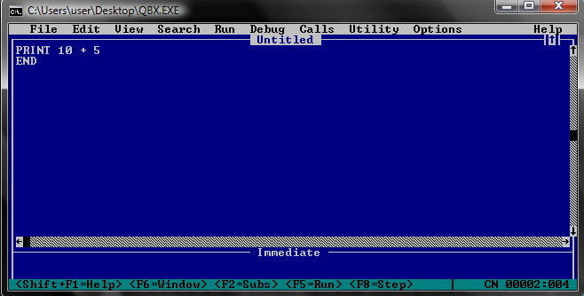
What will be the output of this program?

Slide 24
OUTPUT

Slide 25
Do you suppose that the following program is correct?
END
PRINT 10 + 5

Slide 26
Answer: NO

Slide 27
REMEMBER!
The computer follows instructions in order. If the first instruction is END, the computer ends its run of the program.

Slide 28
MORE OF THE “PRINT” COMMAND
You can use multiple print statements in your program.
PRINT "Hello"
PRINT "World"
Output:
Hello
World

Slide 29
USE OF SEMI - COLON
To place World onto the previous line, place a semi-colon after PRINT "Hello".
PRINT "Hello";
PRINT "World"
Output:
HelloWorld

Slide 30
USE OF COMMA
Also, if you put a comma instead of a semi-colon on the first line, the program will insert spaces between the two words.
PRINT "Hello",
PRINT "World”
Output:
Hello World

