Slide 1
In algebra, what do you call symbols like "x" and "y" , as in 3x² + 2y ?

Slide 2
ANSWER:
VARIABLES

Slide 3
VARIABLES
A variable is a primary storage location that can hold different numeric or alphanumeric values.

Slide 4
A variable is like a small box that holds a value.
The value in the variable can change (that is why it is called a variable).
NUM1
15

Slide 5
The following program prints the variable X to the screen:
PRINT X
Since the variable hasn't been assigned a number, the value of the variable is 0. So, the output of the program is:
0

Slide 6
This next program sets X to 15, and then prints the variable:
LET X = 15
PRINT X
This time, the output is:
15

Slide 7
Variable names can have a combination of letters and numbers. The following are valid variables:
intNum
VALUE
num1
sum

Slide 8
Also, you can use multiple variables in your program.
LET X = 82
LET Y = 101
LET Z = 79
PRINT X
PRINT Y
PRINT Z

Slide 9
Output:
82
101
79

Slide 10
EXPRESSIONS
If you pass an expression to a variable, the expression is evaluated and the variable is set to that value.

Slide 11
LET x = 500 + (10 * 7)
PRINT x
Output:
570

Slide 12
Plus, you can have both variables and numbers in an expression.
X = 100
Y = X * 7
PRINT Y
Output:
700

Slide 13
Plus, you can have both variables and numbers in an expression.
X = 100
Y = X * 7
PRINT Y
Output:
700

Slide 14
SAMPLE PROGRAM 1
Create a program that will convert 100 mg to g.
LET GRAM = 1000
LET MG = 100
LET RESULT = MG / GRAM
PRINT RESULT

Slide 15
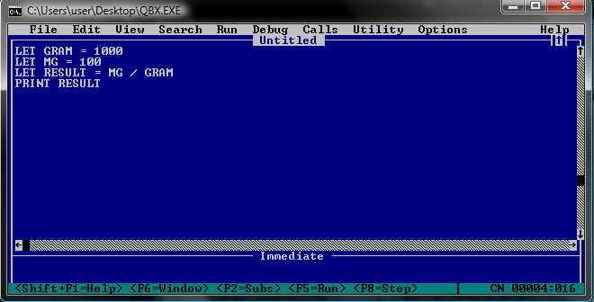
SAMPLE PROGRAM 1
Create a program that will convert 100 mg to g.

Slide 16
OUTPUT
Create a program that will convert 100 mg to g.

Slide 17
SAMPLE PROGRAM 2
Create a program that will convert 15 kg to g.
LET GRAM = 1000
LET KG = 15
LET RESULT = KG * GRAM
PRINT RESULT

Slide 18
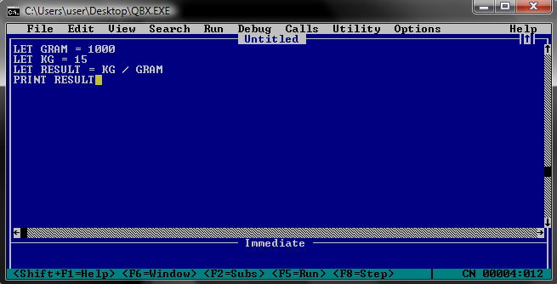
SAMPLE PROGRAM 2
Create a program that will convert 15 kg to g.

Slide 19
OUTPUT
Create a program that will convert 15 kg to g.

